Slide 1
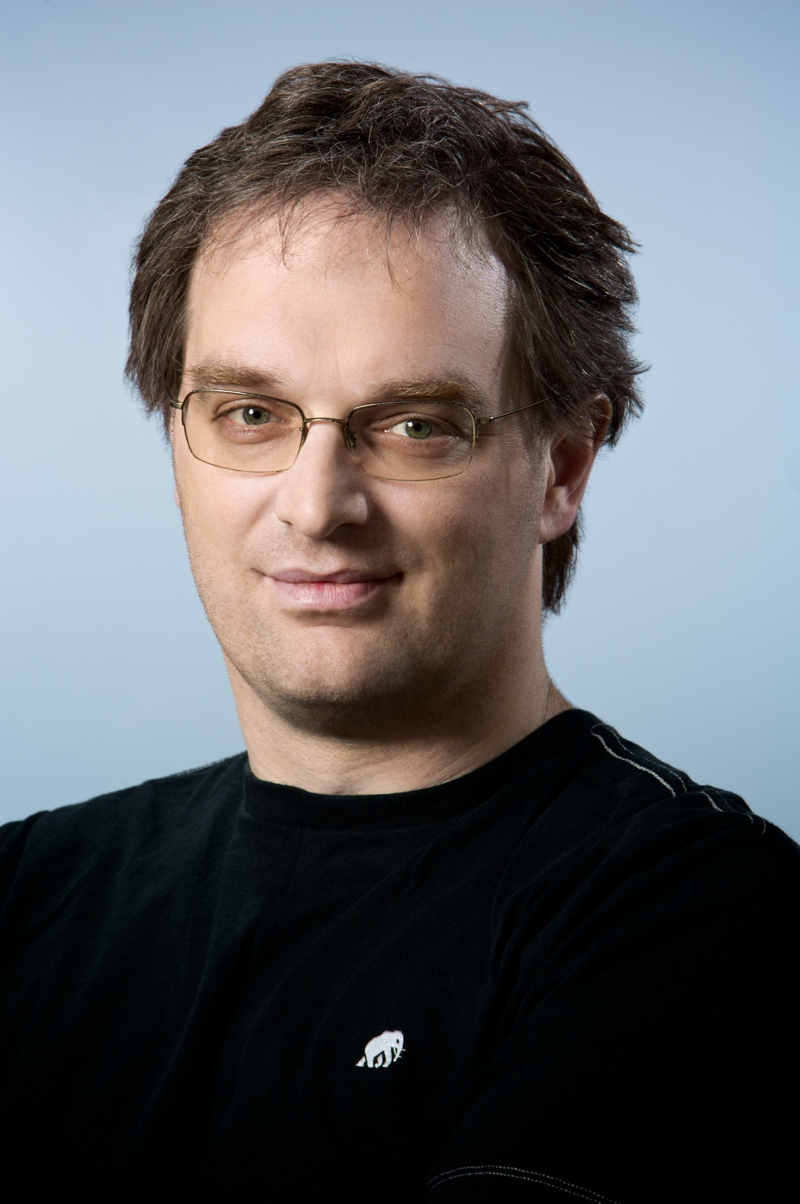
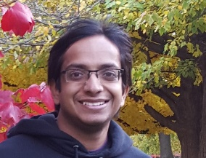
Real World Interactive Learning
Alekh Agarwal
John Langford
ICML Tutorial, August 6

Slide 2
Outline
Algs & Theory Overview
Things that go wrong in practice
Systems for going right
Really doing it in practice

Slide 3
Recap so far
Interactive feedback useful and common
Need randomized exploration
Evaluate arbitrary policies
Optimize using supervised ML techniques
Efficient explore-exploit techniques

Slide 4



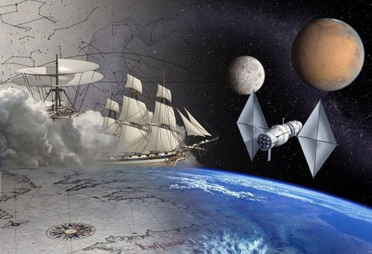
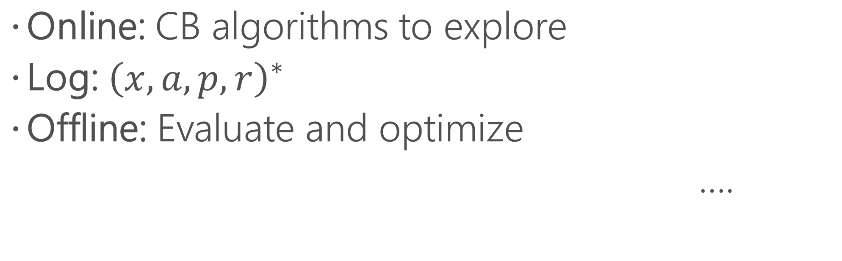
A recipe for success
Online: CB algorithms to explore
Log: ${\left(x,a,p,r\right)}^{∗}$
Offline: Evaluate and optimize
….
Find better features
Try different learning algorithms
Improve exploration strategy

Slide 5

A recipe for success?
Implement the learning algorithm
Integrate with application
H
App
H
Learn

Slide 6
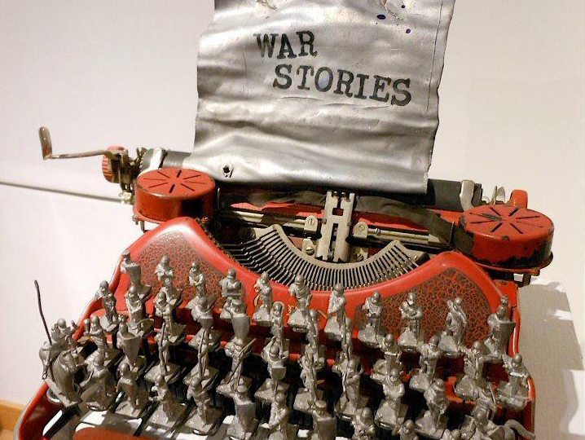

Slide 7
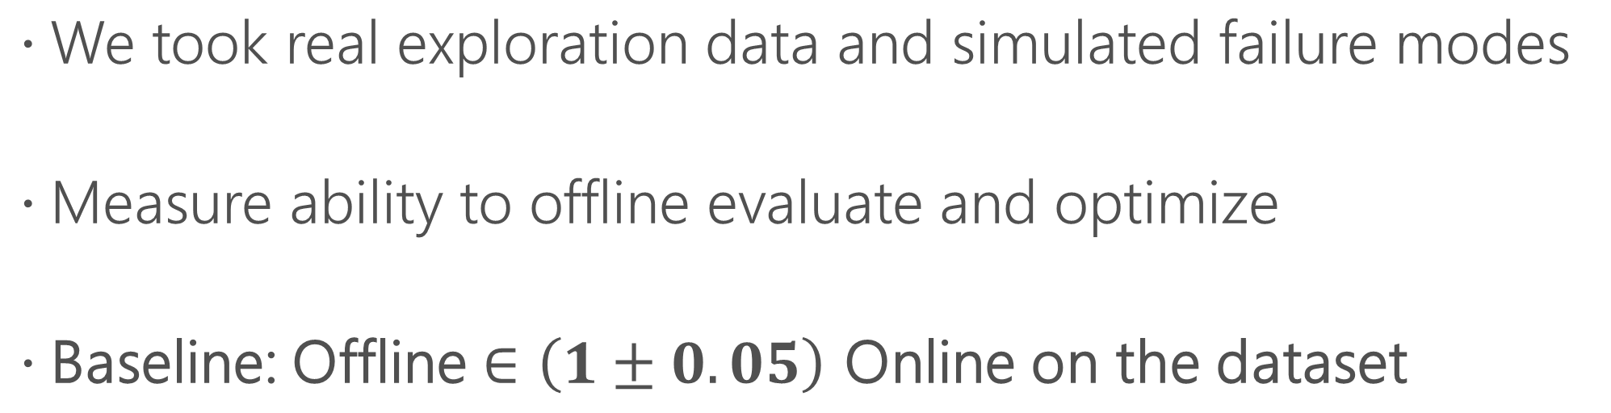
Illustration of failure modes
We took real exploration data and simulated failure modes
Measure ability to offline evaluate and optimize
Baseline: Offline $∈\left(1±0.05\right)$ Online on the dataset

Slide 8


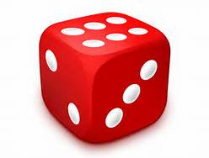
Failure mode: wrong probabilities
Randomization
Policy

Slide 9
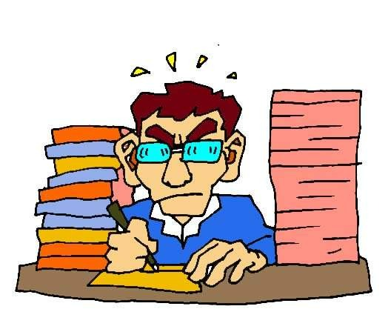
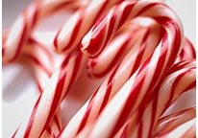
Failure mode: wrong probabilities
Logs record article shown to user, not chosen by algorithm
Editor
Randomization
Policy

Slide 10

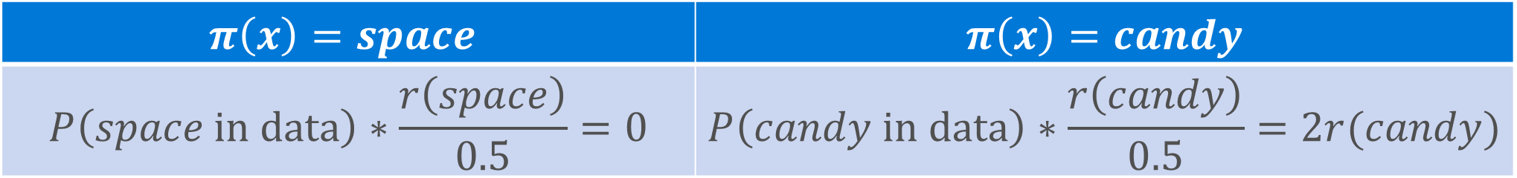
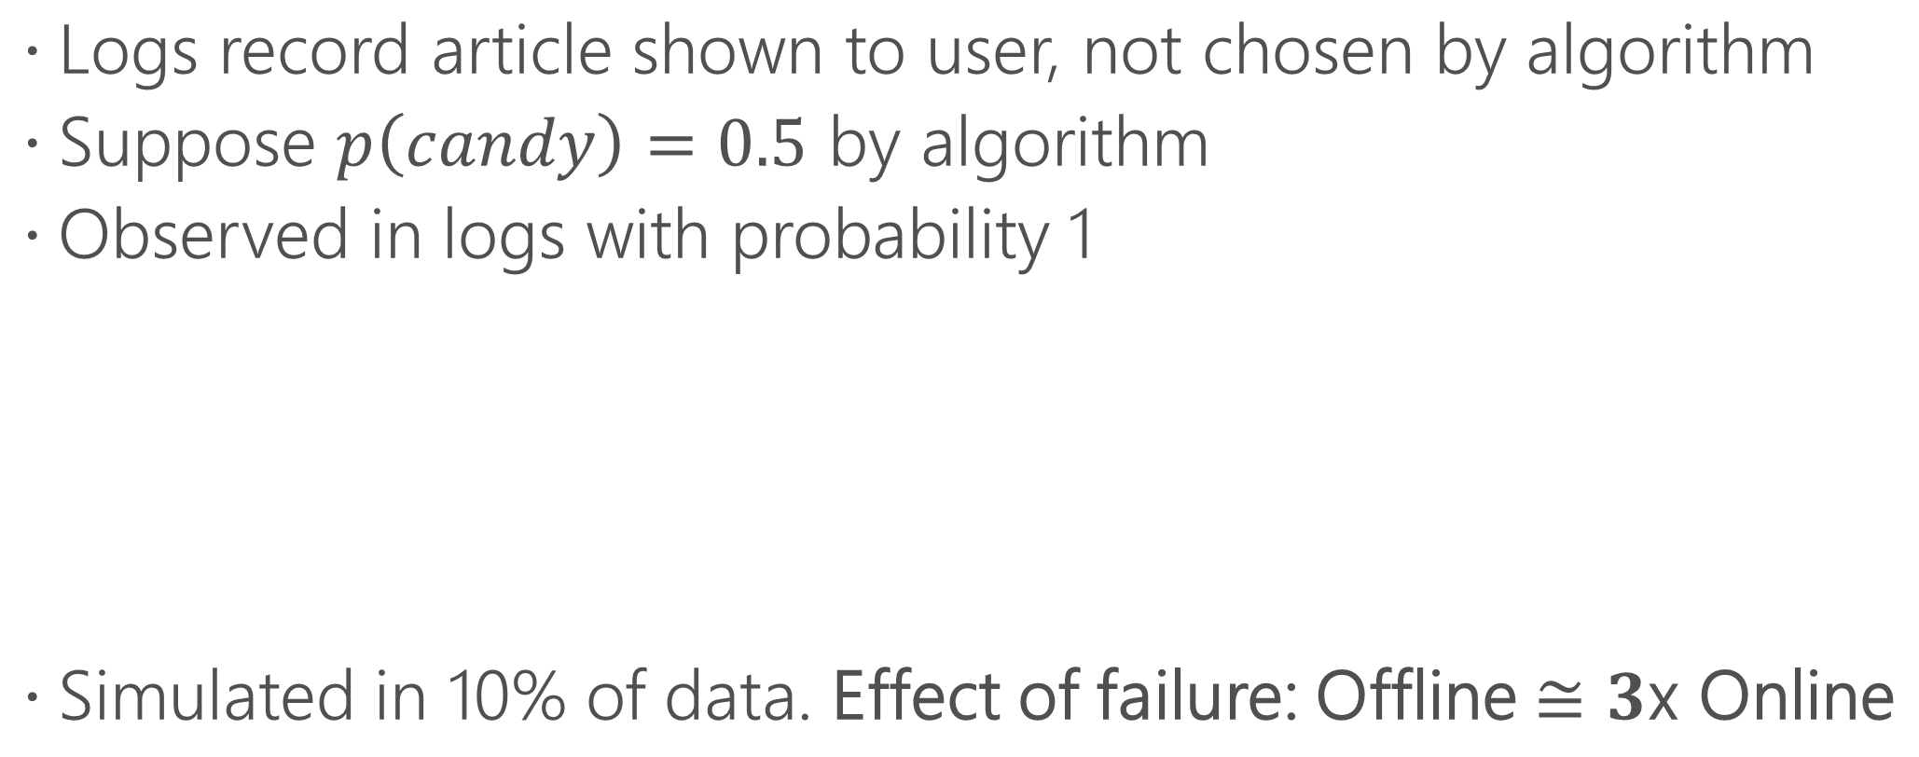
Failure mode: wrong probabilities
Logs record article shown to user, not chosen by algorithm
Suppose $p\left(candy\right)=0.5$ by algorithm
Observed in logs with probability 1
Simulated in 10% of data. Effect of failure: Offline $≅3$x Online
$$π\left(x\right)=space$$ | $π\left(x\right)=candy$
$$P\left(space \text{in} \text{data}\right)∗\frac{r\left(space\right)}{0.5}=0$$ | $$P\left(candy \text{in} \text{data}\right)∗\frac{r\left(candy\right)}{0.5}=2r(candy)$$

Slide 11
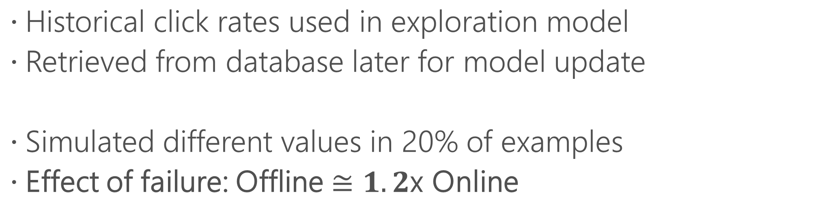
Failure mode: wrong features
Historical click rates used in exploration model
Retrieved from database later for model update
Simulated different values in 20% of examples
Effect of failure: Offline $≅1.2$x Online
Learn
Explore

Slide 12
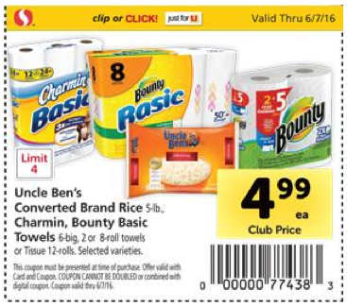

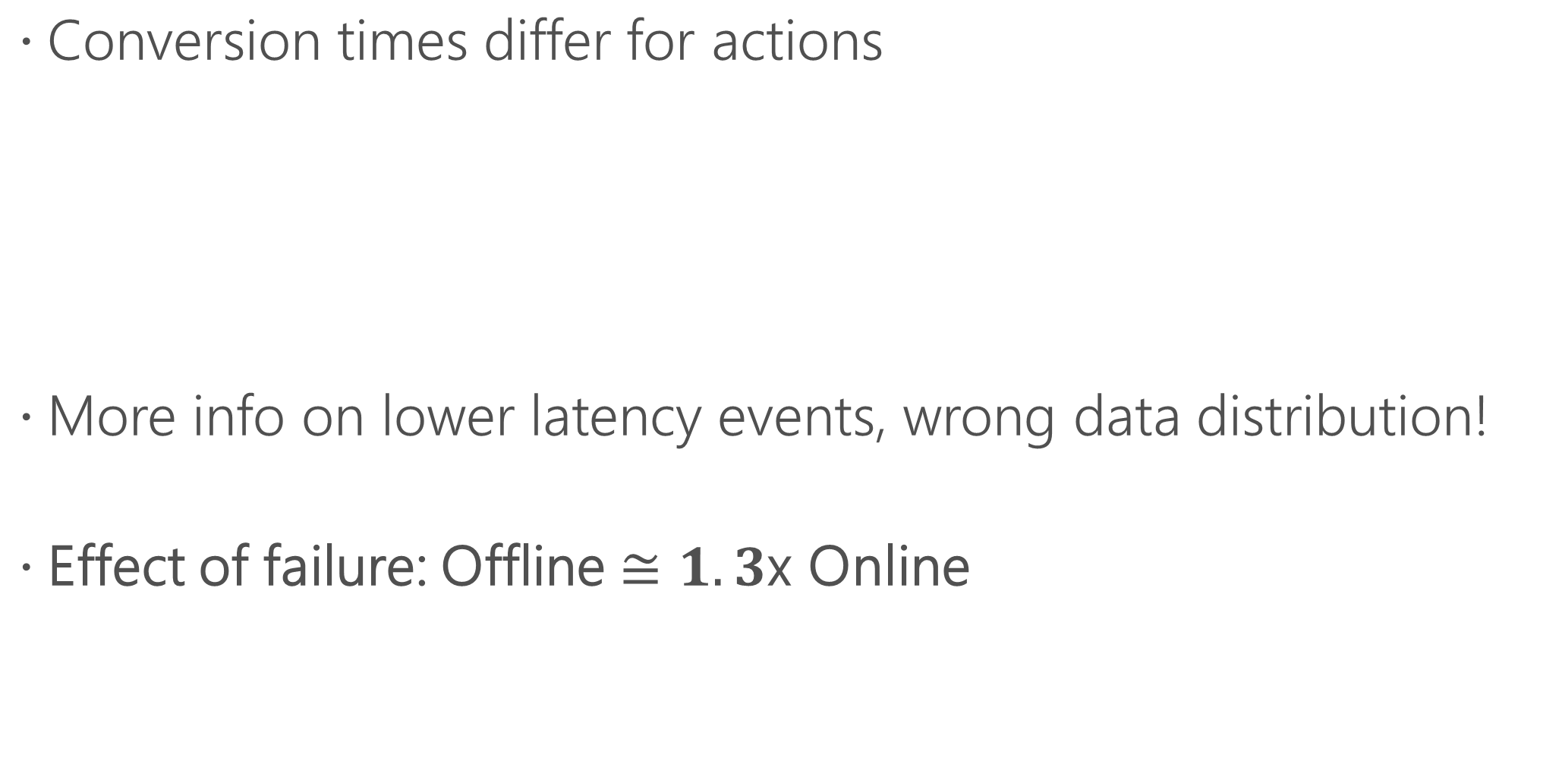
Failure mode: reward delay bias
Conversion times differ for actions
More info on lower latency events, wrong data distribution!
Effect of failure: Offline $≅1.3$x Online
In store
Online

Slide 13

Failure modes
Wrong probabilities
Wrong features
Unequal reward latencies
No probabilities, decision used as feature downstream, events missing not randomly,…
Similar observations in [SHGDPECY ’14]
Unreliable offline evaluation and optimization

Slide 14
A recipe for success?
Part of a larger system with interacting pieces
Not enough to ensure correctness of the learning algorithm
Explore
Log
Deploy
Learn

Slide 15
Outline
Algs & Theory Overview
Things that go wrong in practice
Systems for going right
Really doing it in practice

Slide 16
Desiderata
Each component correct in isolation
Single, modular, scalable system that pieces them together
Easy to use, general purpose
Fully offline reproducible
Explore
Log
Deploy
Learn

Slide 17


Decision Service [ABCHLLLMORSS ‘16]
https://github.com/Microsoft/mwt-ds/
Open-source on Github
Host and manage yourself
https://ds.microsoft.com
Hosted as a Microsoft Cognitive Service
Logging and model deployment managed
Data logged to your Azure account
Contextual bandits optimize decisions online
Off-policy evaluation and monitoring

Slide 18
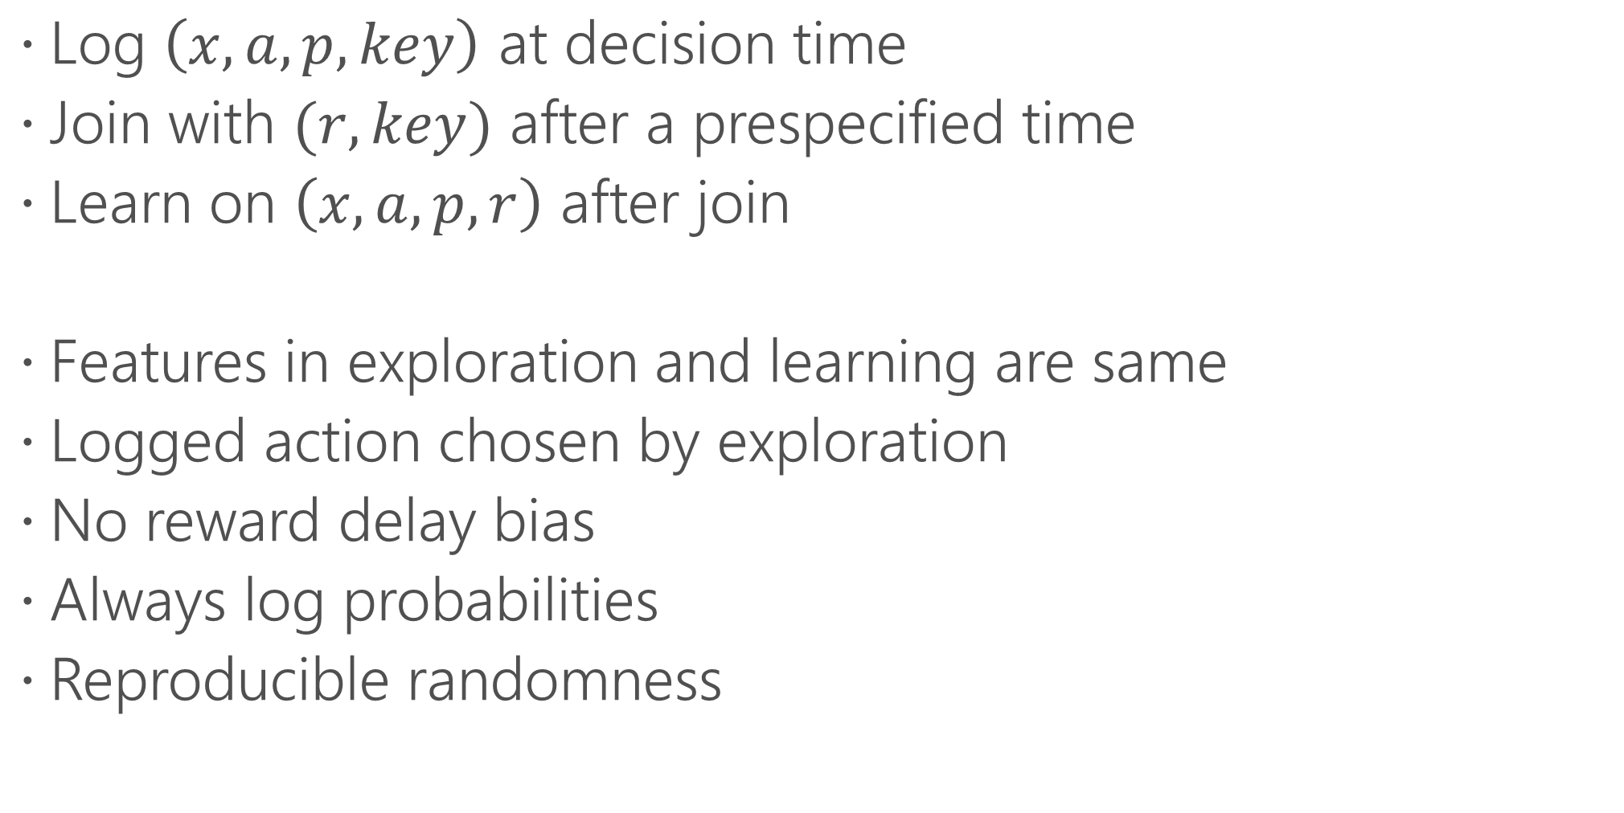
Eliminates bugs by design
Log $\left(x,a, p, key\right)$ at decision time
Join with $(r,key)$ after a prespecified time
Learn on $\left(x,a,p,r\right)$ after join
Features in exploration and learning are same
Logged action chosen by exploration
No reward delay bias
Always log probabilities
Reproducible randomness

Slide 19
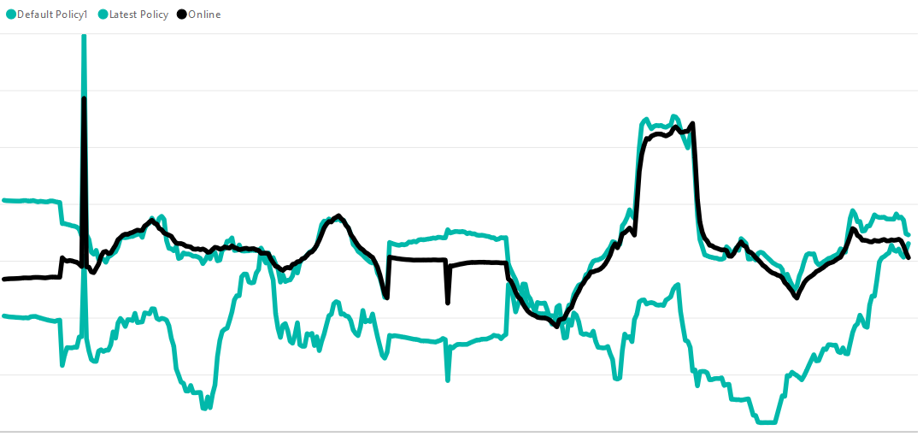
System’s actual online performance
Offline estimate of system’s performance
Offline estimate of baseline’s performance

Slide 20
Systems survey
Decision Service [ABCHLLLMORSS ‘16] | NEXT [JJFGN ‘15] | StreamingBandit [KK ‘16]
Online CB with general policies | MAB, linear CB, dueling | Thompson Sampling
Off-policy eval/optimization | - | -
Open source and self-hosted on Azure | Open source and self-hosted on EC2 | Open source and self-hosted locally
Managed on Azure | - | -

Slide 21
Take-aways
Good fit for many problems
Fundamental questions have useful answers
Need for system and systems exist

Slide 22
Outline
Algs & Theory Overview
Things that go wrong in practice
Systems for going right
Really doing it in practice
Non-stationarity
Combinatorial actions
Reward definition

Slide 23

Practical Lessons

Slide 24

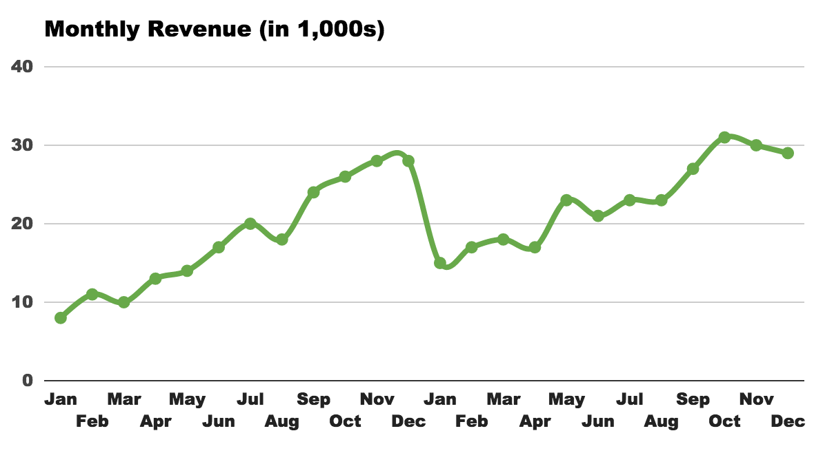
Non-stationarity
Best policy in hindsight changes
New actions, e.g.: news articles, products, ads etc. are added
Periodic trends in preferences

Slide 25
Non-stationarity
Best policy in hindsight changes
MSN model trained on day 1, relative to models trained on days 2 and 3

Slide 26
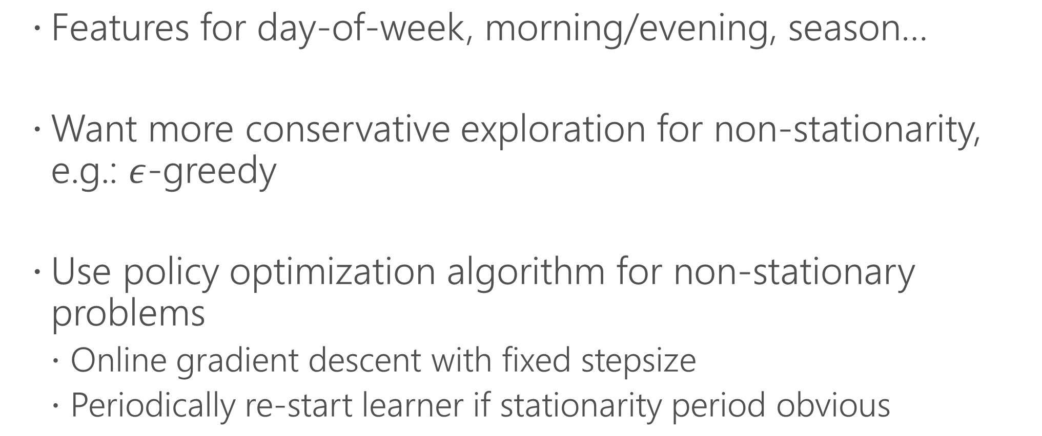
Non-stationarity: practical fixes
Features for day-of-week, morning/evening, season…
Want more conservative exploration for non-stationarity, e.g.: $ε$-greedy
Use policy optimization algorithm for non-stationary problems
Online gradient descent with fixed stepsize
Periodically re-start learner if stationarity period obvious

Slide 27
Non-stationarity: research directions
No agreed upon benchmark for non-stationary problems
EXP4 with higher uniform exploration, computationally inefficient
Aggregate learners over different times, weak bounds [ALNS ‘17]
Simple fixes tend to be quite robust, more research needed

Slide 28
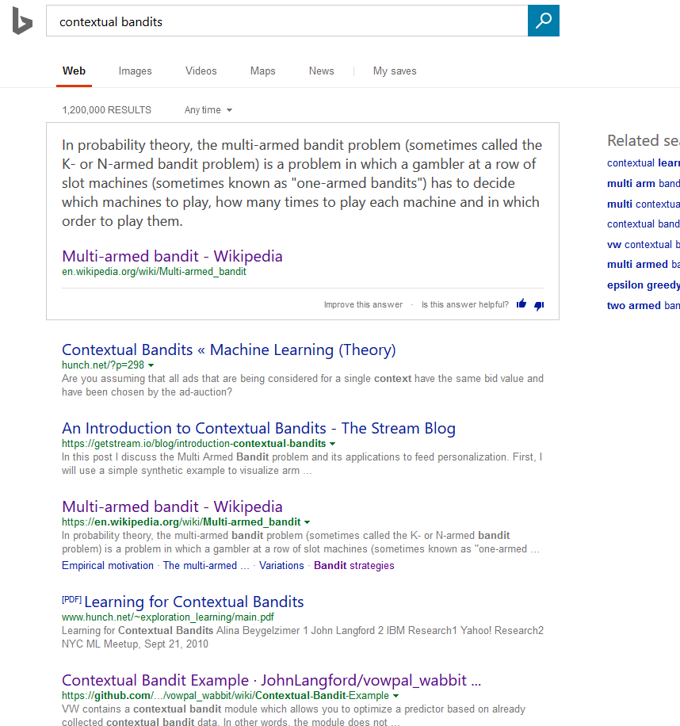

Combinatorial actions
How to optimize choice of rankings, slideshows and other complex page layouts?

Slide 29
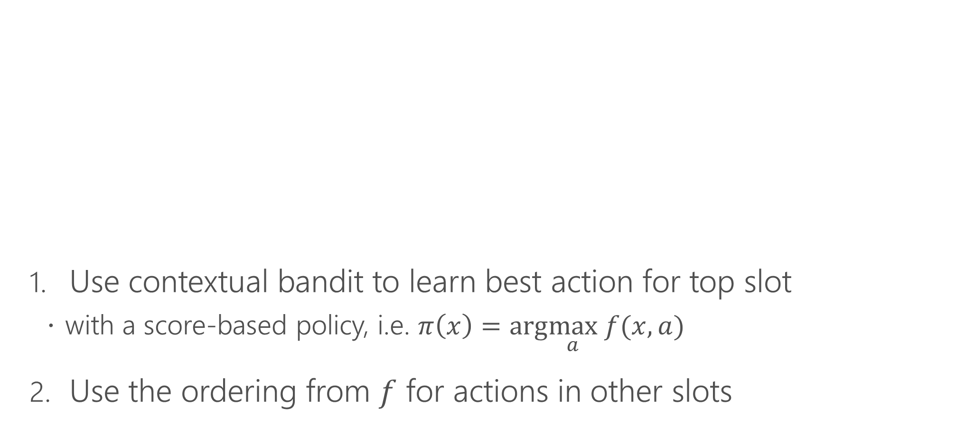
Combinatorial actions
Use contextual bandit to learn best action for top slot
with a score-based policy, i.e. $π\left(x\right)=arg\max_{a} f(x,a)$
Use the ordering from $f$ for actions in other slots
Explore here

Slide 30
Combinatorial actions: better fixes
Number of models for combinatorial actions
Semibandits [KRS’10, KWAS’15a, KAD ’16]: sum of observed per-action rewards
Slates [KRS’10, SKADLJZ ‘15]: sum of unobserved per-action rewards
Cascading models [KWAS’15b, LWZC’ 16]: observed rewards on only a prefix of actions matter, e.g. user stops reading
Diverse rankings [RKJ’08, SG’08, SRG’13]: use techniques from submodular optimization. E.g.: separate bandit for each slot as greedy algorithm
Different modeling assumptions in each, pick depending on your application

Slide 31
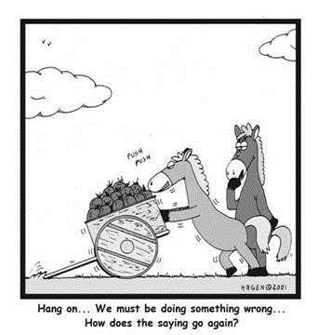
Reward definition
Great at optimizing given reward function
What reward function to use?

Slide 32
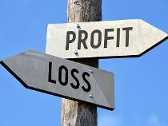

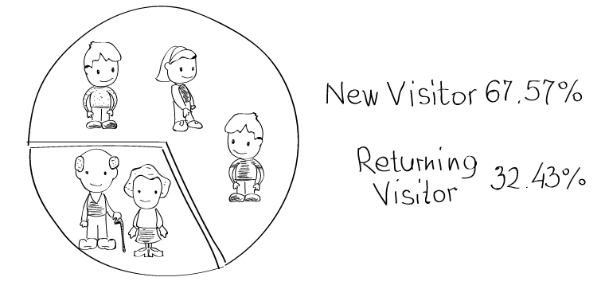
Reward definition
CB reward associated with a given (context, action)
Short-term proxies for long-term rewards
Clicks or dwell-time for user satisfaction
Exercise minutes in a day for weight-loss
Long-term reward predictor can be good short-term proxy
Quarterly profits
Weight loss
Number of returning users

Slide 33
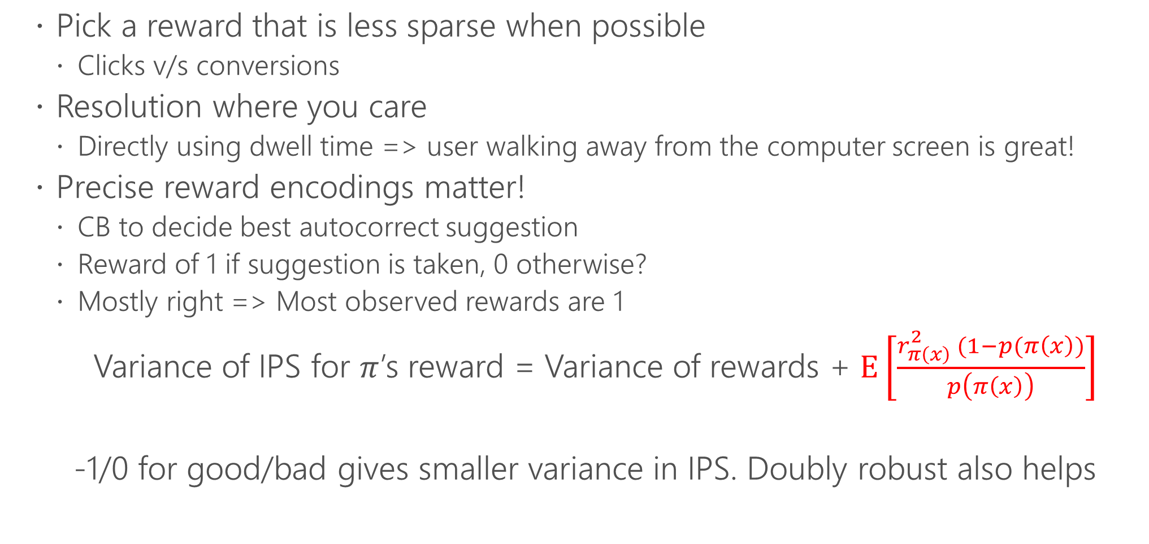
Reward definition: practical tricks
Pick a reward that is less sparse when possible
Clicks v/s conversions
Resolution where you care
Directly using dwell time => user walking away from the computer screen is great!
Precise reward encodings matter!
CB to decide best autocorrect suggestion
Reward of 1 if suggestion is taken, 0 otherwise?
Mostly right => Most observed rewards are 1
Variance of IPS for $π$’s reward = Variance of rewards + $\text{E}\left[\frac{r_{π\left(x\right)}^{2} (1−p(π\left(x\right))}{p\left(π\left(x\right)\right)}\right]$
-1/0 for good/bad gives smaller variance in IPS. Doubly robust also helps
Bad dependence on importance weights if most costs are 1!

Slide 34
Take-aways
Good fit for many problems
Fundamental questions have useful answers
Need for system and systems exist
Recipes for applying to common scenarios

Slide 35


Slide 36
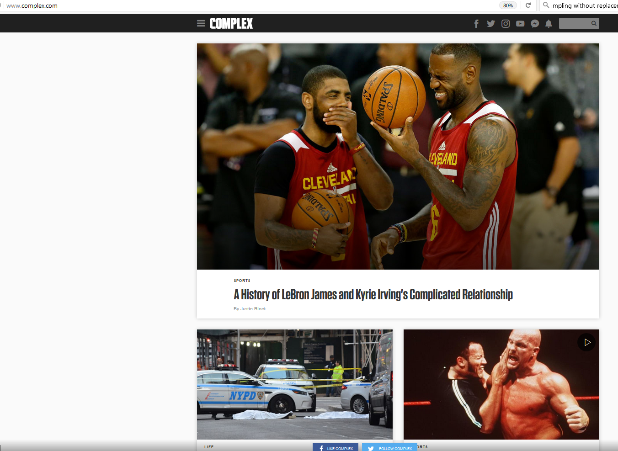
Data
Data from www.complex.com
for personalizing articles
Modified click information to protect true CTRs

Slide 37
Data
{"_label_cost":0,"_label_probability":0.8181818,"_label_Action":4,"_labelIndex":3,"Version":"1","EventId":"43ad5284ca1647f58232856eaf6c8e89","a":[4,8,2,9,11,3,10,7,5,6,1],"c":{"_synthetic":false,"User":{"_age":0},"Geo":{"country":"United States", "_countrycf":"8","state":"Texas","city":"Lubbock","_citycf":"5","dma":"651"},"MRefer":{"referer":"http://www.complex.com/"},"OUserAgent":{"_ua":"Mozilla/5.0 (iPhone; CPU iPhone OS 10_3_2 like Mac OS X) AppleWebKit/603.2.4 (KHTML, like Gecko) Version/10.0 Mobile/14F89 Safari/602.1","_DeviceBrand":"Apple","_DeviceFamily":"iPhone","_DeviceIsSpider":false, "_DeviceModel":"iPhone","_OSFamily":"iOS","_OSMajor":"10","_OSPatch":"2","DeviceType":"Mobile"},"_multi":[{"_tag":"cmplx$http://www.complex.com/pop-culture/2017/07/spider-man-homecoming-review","i":{"constant":1, "id":"cmplx$http://www.complex.com/pop-culture/2017/07/spider-man-homecoming-review"},"j":[{"_title":"'Spider-Man: Homecoming' Gives A Middle Finger to the Origin Story"},{"RVisionTags":{"outdoor":0.987059832,"person":0.9200916, "train":0.5535795,"carrying":0.5407937},"SVisionAdult":{"isAdultContent":false,"isRacyContent":false,"adultScore":0.0119066667,"racyScore":0.020404214},"TVisionCelebrities":{"Tom Holland":0.975926459},"_expires":"2017-07 10T15:42:34.9416903Z"}, {"Emotion0":{"anger":0.00441879639,"contempt":0.008356918,"disgust":0.000186958685,"fear":8.14791747E-06,"happiness":0.000101474114,"neutral":0.9849495,"sadness":0.00184323045,"surprise":0.00013493665},"_expires":"2017-07-10T15:42:32.238409Z,{"XSentiment":0.9998798,"_expires":"2017-07-10T15:42:33.0041111Z"}]},

Slide 38
Data
{"_label_cost":0,"_label_probability":0.8181818,"_label_Action":4,"_labelIndex":3,"Version":"1","EventId":"43ad5284ca1647f58232856eaf6c8e89","a":[4,8,2,9,11,3,10,7,5,6,1],"c":{"_synthetic":false,"User":{"_age":0},"Geo":{"country":"United States", "_countrycf":"8","state":"Texas","city":"Lubbock","_citycf":"5","dma":"651"},"MRefer":{"referer":"http://www.complex.com/"},"OUserAgent":{"_ua":"Mozilla/5.0 (iPhone; CPU iPhone OS 10_3_2 like Mac OS X) AppleWebKit/603.2.4 (KHTML, like Gecko) Version/10.0 Mobile/14F89 Safari/602.1","_DeviceBrand":"Apple","_DeviceFamily":"iPhone","_DeviceIsSpider":false, "_DeviceModel":"iPhone","_OSFamily":"iOS","_OSMajor":"10","_OSPatch":"2","DeviceType":"Mobile"},"_multi":[{"_tag":"cmplx$http://www.complex.com/pop-culture/2017/07/spider-man-homecoming-review","i":{"constant":1, "id":"cmplx$http://www.complex.com/pop-culture/2017/07/spider-man-homecoming-review"},"j":[{"_title":"'Spider-Man: Homecoming' Gives A Middle Finger to the Origin Story"},{"RVisionTags":{"outdoor":0.987059832,"person":0.9200916, "train":0.5535795,"carrying":0.5407937},"SVisionAdult":{"isAdultContent":false,"isRacyContent":false,"adultScore":0.0119066667,"racyScore":0.020404214},"TVisionCelebrities":{"Tom Holland":0.975926459},"_expires":"2017-07 10T15:42:34.9416903Z"}, {"Emotion0":{"anger":0.00441879639,"contempt":0.008356918,"disgust":0.000186958685,"fear":8.14791747E-06,"happiness":0.000101474114,"neutral":0.9849495,"sadness":0.00184323045,"surprise":0.00013493665},"_expires":"2017-07-10T15:42:32.238409Z,{"XSentiment":0.9998798,"_expires":"2017-07-10T15:42:33.0041111Z"}]},

Slide 39
Data
{"_label_cost":0,"_label_probability":0.8181818,"_label_Action":4,"_labelIndex":3,"Version":"1","EventId":"43ad5284ca1647f58232856eaf6c8e89","a":[4,8,2,9,11,3,10,7,5,6,1],"c":{"_synthetic":false,"User":{"_age":0},"Geo":{"country":"United States", "_countrycf":"8","state":"Texas","city":"Lubbock","_citycf":"5","dma":"651"},"MRefer":{"referer":"http://www.complex.com/"},"OUserAgent":{"_ua":"Mozilla/5.0 (iPhone; CPU iPhone OS 10_3_2 like Mac OS X) AppleWebKit/603.2.4 (KHTML, like Gecko) Version/10.0 Mobile/14F89 Safari/602.1","_DeviceBrand":"Apple","_DeviceFamily":"iPhone","_DeviceIsSpider":false, "_DeviceModel":"iPhone","_OSFamily":"iOS","_OSMajor":"10","_OSPatch":"2","DeviceType":"Mobile"},"_multi":[{"_tag":"cmplx$http://www.complex.com/pop-culture/2017/07/spider-man-homecoming-review","i":{"constant":1, "id":"cmplx$http://www.complex.com/pop-culture/2017/07/spider-man-homecoming-review"},"j":[{"_title":"'Spider-Man: Homecoming' Gives A Middle Finger to the Origin Story"},{"RVisionTags":{"outdoor":0.987059832,"person":0.9200916, "train":0.5535795,"carrying":0.5407937},"SVisionAdult":{"isAdultContent":false,"isRacyContent":false,"adultScore":0.0119066667,"racyScore":0.020404214},"TVisionCelebrities":{"Tom Holland":0.975926459},"_expires":"2017-07 10T15:42:34.9416903Z"}, {"Emotion0":{"anger":0.00441879639,"contempt":0.008356918,"disgust":0.000186958685,"fear":8.14791747E-06,"happiness":0.000101474114,"neutral":0.9849495,"sadness":0.00184323045,"surprise":0.00013493665},"_expires":"2017-07-10T15:42:32.238409Z,{"XSentiment":0.9998798,"_expires":"2017-07-10T15:42:33.0041111Z"}]},

Slide 40
Evaluating policies
Pick a policy class
Progressive validation of best policy in the class using IPS
vw --cb_adf -d complex.moreclicks.json --dsjson -t
Data file
Evaluate a baseline model, specified through action order

Slide 41
Evaluating policies
Pick a policy class
Progressive validation of best policy in the class using IPS
vw --cb_adf -d complex.moreclicks.json --dsjson -t
Value: 0.078104

Slide 42
Evaluating policies
Pick a policy class
Progressive validation of best policy in the class using IPS
vw --cb_adf -d complex.moreclicks.json --dsjson -t
Value: 0.078104
vw -d complex.moreclicks.json --cb_adf --dsjson -c --power_t 0 -l 0.0005 -q GT -q ME -q MR -q OE
Data file

Slide 43
Evaluating policies
Pick a policy class
Progressive validation of best policy in the class using IPS
vw --cb_adf -d complex.moreclicks.json --dsjson -t
Value: 0.078104
vw -d complex.moreclicks.json --cb_adf --dsjson -c --power_t 0 -l 0.0005 -q GT -q ME -q MR -q OE
Contextual bandit data with per action features

Slide 44
Evaluating policies
Pick a policy class
Progressive validation of best policy in the class using IPS
vw --cb_adf -d complex.moreclicks.json --dsjson -t
Value: 0.078104
vw -d complex.moreclicks.json --cb_adf --dsjson -c --power_t 0 -l 0.0005 -q GT -q ME -q MR -q OE
JSON input

Slide 45
Evaluating policies
Pick a policy class
Progressive validation of best policy in the class using IPS
vw --cb_adf -d complex.moreclicks.json --dsjson -t
Value: 0.078104
vw -d complex.moreclicks.json --cb_adf --dsjson -c --power_t 0 -l 0.0005 -q GT -q ME -q MR -q OE
Use constant learning rate for non-stationary problem

Slide 46
Evaluating policies
Pick a policy class
Progressive validation of best policy in the class using IPS
vw --cb_adf -d complex.moreclicks.json --dsjson -t
Value: 0.078104
vw -d complex.moreclicks.json --cb_adf --dsjson -c --power_t 0 -l 0.0005 -q GT -q ME -q MR -q OE
Value of learning rate

Slide 47
Evaluating policies
Pick a policy class
Progressive validation of best policy in the class using IPS
vw --cb_adf -d complex.moreclicks.json --dsjson -t
Value: 0.078104
vw -d complex.moreclicks.json --cb_adf --dsjson -c --power_t 0 -l 0.0005 -q GT -q ME -q MR -q OE
Pairwise interaction features for these namespaces

Slide 48
Evaluating policies
Pick a policy class
Progressive validation of best policy in the class using IPS
vw --cb_adf -d complex.moreclicks.json --dsjson -t
Value: 0.078104
vw -d complex.moreclicks.json --cb_adf --dsjson -c --power_t 0 -l 0.0005 -q GT -q ME -q MR -q OE
Value: 0.222949

Slide 49
Evaluating exploration algorithms
Pick a policy class and exploration algorithm
Rejection sampling to evaluate
vw --explore_eval -d complex.moreclicks.json --dsjson -c --power_t 0 -l 0.0005 -q GT -q ME -q MR -q OE --epsilon 0.1
Evaluate exploration algorithm

Slide 50

Evaluating exploration algorithms
Pick a policy class and exploration algorithm
Rejection sampling to evaluate
vw --explore_eval -d complex.moreclicks.json --dsjson -c --power_t 0 -l 0.0005 -q GT -q ME -q MR -q OE --epsilon 0.1
$ε$-greedy

Slide 51
Evaluating exploration algorithms
Pick a policy class and exploration algorithm
Rejection sampling to evaluate
vw --explore_eval -d complex.moreclicks.json --dsjson -c --power_t 0 -l 0.0005 -q GT -q ME -q MR -q OE --epsilon 0.1
Value: 0.153581

Slide 52
Evaluating exploration algorithms
Pick a policy class and exploration algorithm
Rejection sampling to evaluate
vw --explore_eval -d complex.moreclicks.json --dsjson -c --power_t 0 -l 0.0005 -q GT -q ME -q MR -q OE --epsilon 0.1
Value: 0.153581
vw --explore_eval -d complex.moreclicks.json --dsjson -c --power_t 0 -l 0.00025 -q GT -q ME -q MR -q OE --cover 4 --epsilon 0.05
Online cover [AHKLLS ‘14]

Slide 53
Evaluating exploration algorithms
Pick a policy class and exploration algorithm
Rejection sampling to evaluate
vw --explore_eval -d complex.moreclicks.json --dsjson -c --power_t 0 -l 0.0005 -q GT -q ME -q MR -q OE --epsilon 0.1
Value: 0.153581
vw --explore_eval -d complex.moreclicks.json --dsjson -c --power_t 0 -l 0.00025 -q GT -q ME -q MR -q OE --cover 4 --epsilon 0.05
Value: 0.207942

Slide 54
Concluding Remarks
Contextual bandits research mature for consumption
More advanced questions like non-stationarity still open
Enables problems well beyond supervised learning and works much more easily than general RL
More automatic algorithms?
Broader subsets of RL?
New applications?

Slide 55
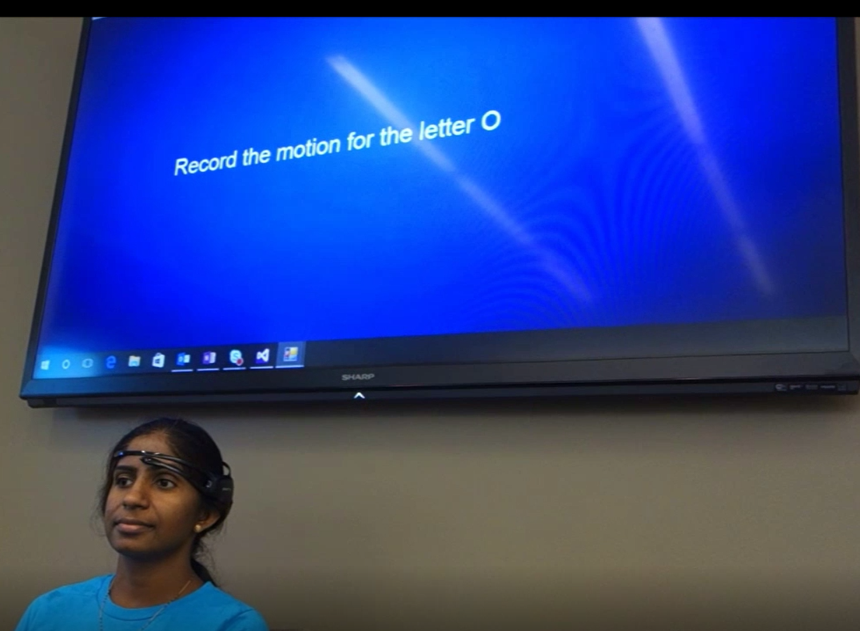
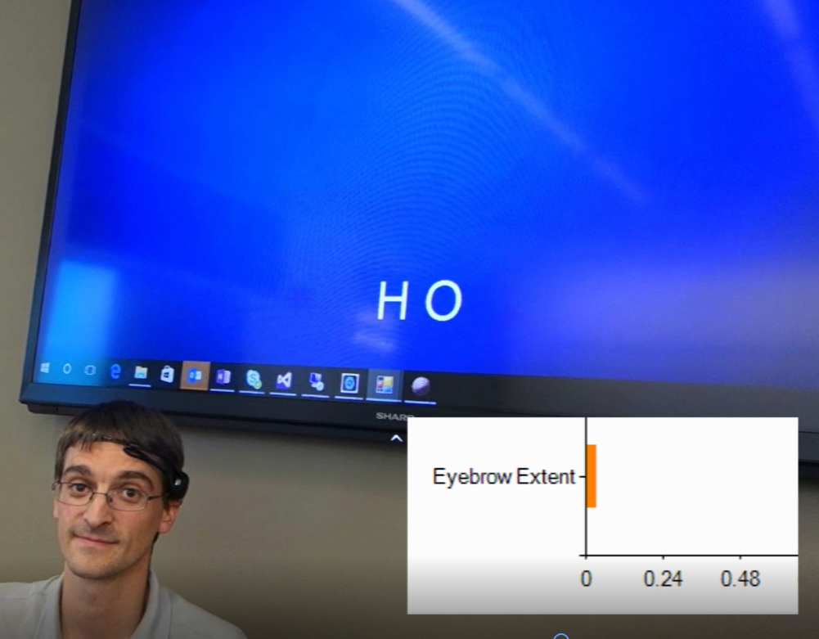
Initial supervision
CB personalization
Hackathon project: Type with EEG
Initial supervised labels give gestures for characters
Tailored to user with Decision Service predicting next letter
Video at https://ds.microsoft.com
EEG

Slide 56
Acknowledgements
Lihong Li | Tong Zhang | Siddhartha Sen | Haipeng Luo
Wei Chu | Daniel Hsu | Alex Slivkins | Behnam Neyshabur
Robert Schapire | Nikos Karampatziakis | Stephen Lee | Akshay Krishnamurthy
Miroslav Dudik | Satyen Kale | Jiaji Li | Adith Swaminathan
Alina Beygelzimer | Lev Reyzin | Dan Melamed | Damien Jose
Avrim Blum | Sarah Bird | Gal Oshri | Imed Zitouni
Adam Kalai | Markus Cozowicz | Oswaldo Ribas | Luong Hoang
Dumitru Erhan
and many others….

Slide 57

Thank You!
Detailed references on http://hunch.net/~rwil

